Slide 1
Student-Teacher Booking Appointment
By
Surukulu Gobinda

Slide 2
INTRODUCTION
My name is Surukulu Gobinda and I joined this program one month ago.
I have worked on two projects, and I will explain these two projects in my report, one by one.
My first project name is Student-Teacher Booking Appointment and my another project name is Gas Agency System.

Slide 3
Student-Teacher Booking Appointment

Slide 4
AIM OF THE PROJECT
Student-teacher booking appointment app is that it allows students to customize their booking process. This includes the ability to select the timeframe, and even the type of appointment they'd like to book. This way, students can easily find the best appointment that fits their needs and schedule.
This study presents a web based appointment booking system through web or mobile devices that assists both students and lecturers to be acquainted with the time of appointment wherever they are.
Student-teacher booking appointment apps are incredibly helpful for students and teachers alike. They make the entire booking process simple and efficient, and with customizable options, students can make sure that their appointments fit their needs.

Slide 5
OBJECTIVE OF THIS PROJECT
The Student-Teacher Booking Appointment app is designed so that both students and teachers have an easy and efficient way to book appointments with each other.
Once the appointment time arrives, you can easily attend the meeting with your teacher. Your teacher will also be able to access all the details regarding the appointment.
For teachers, the app makes it easy to manage and monitor their students’ appointments. They can set their availability, create and manage appointments, send reminders, and review student progress reports.

Slide 6
SOFTWARE USED
Front End: HTML5, CSS
Database: Firebase
Back End: Java Script
Technical Details
Frontend: Developed using HTML, CSS, and JavaScript to provide a responsive and intuitive user experience.
Backend: Utilizes Firebase Firestore for a NoSQL database, allowing for real-time data synchronization and storage.
Hosting: Can be deployed on Firebase Hosting for easy and scalable deployment.

Slide 7
USAGE INSTRUCTIONS
Students:
Register and log in to access the dashboard.
Search for teachers and view their profiles.
Book appointments by selecting a teacher and an available time slot.
Send messages to teachers for queries or clarifications.
Teachers:
Log in to the teacher dashboard.
View all booked appointments and manage them by approving or canceling.
Read messages from students and respond accordingly.
Admin:
Access the admin dashboard after logging in.
Manage users, including adding new teachers or changing user roles.
Oversee all appointments and messages to ensure smooth operation of the platform.

Slide 8
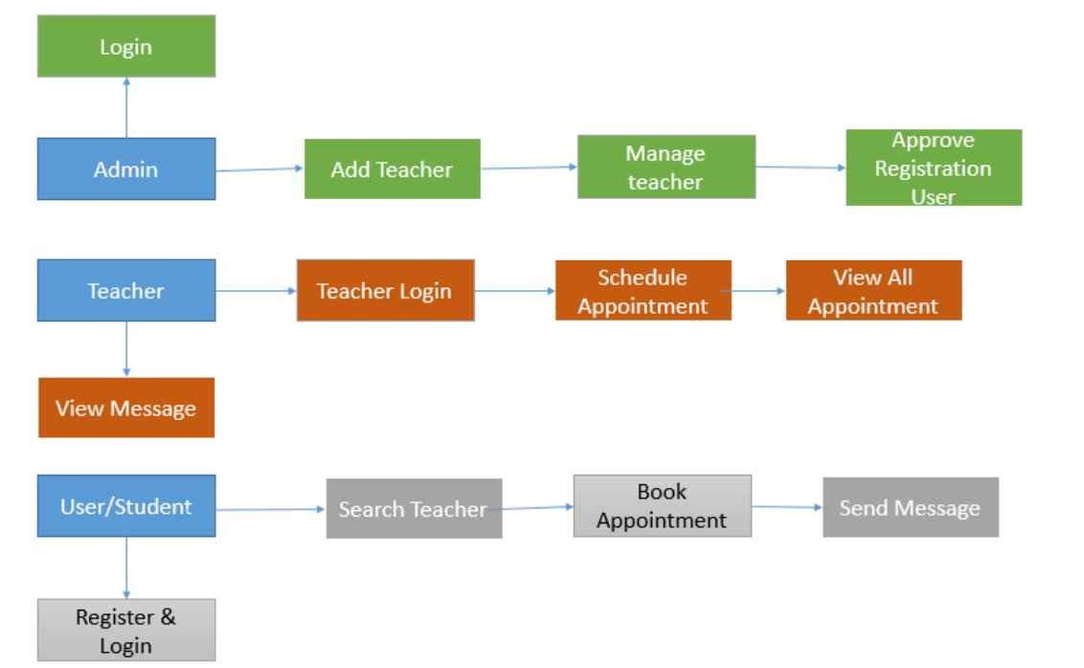
ARCHITECTURE DIAGRAMS

Slide 9
BENEFITS
For Students:
Easy access to teacher schedules and availability.
Simplified process for booking appointments and communicating with teachers.
Enhanced academic support through structured interactions.
For Teachers:
Efficient management of appointments and student interactions.
Streamlined communication channel with students.
Control over schedule and availability to avoid conflicts.
For Admins:
Comprehensive oversight of all platform activities.
Ability to manage and update the system as needed.
Ensures data integrity and user management.

Slide 10
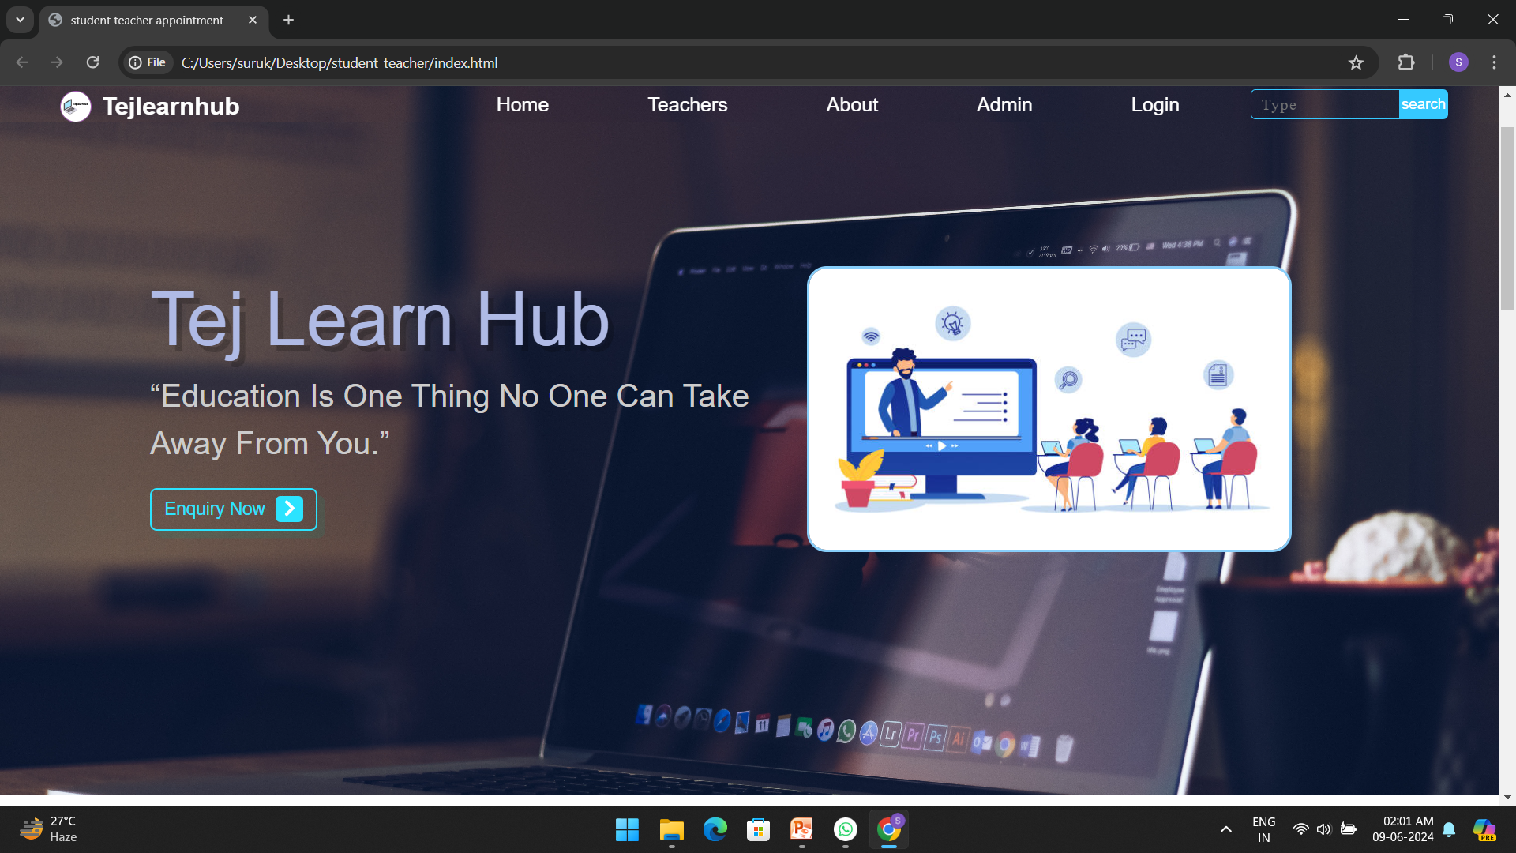
SCREENSHOTS

Slide 11
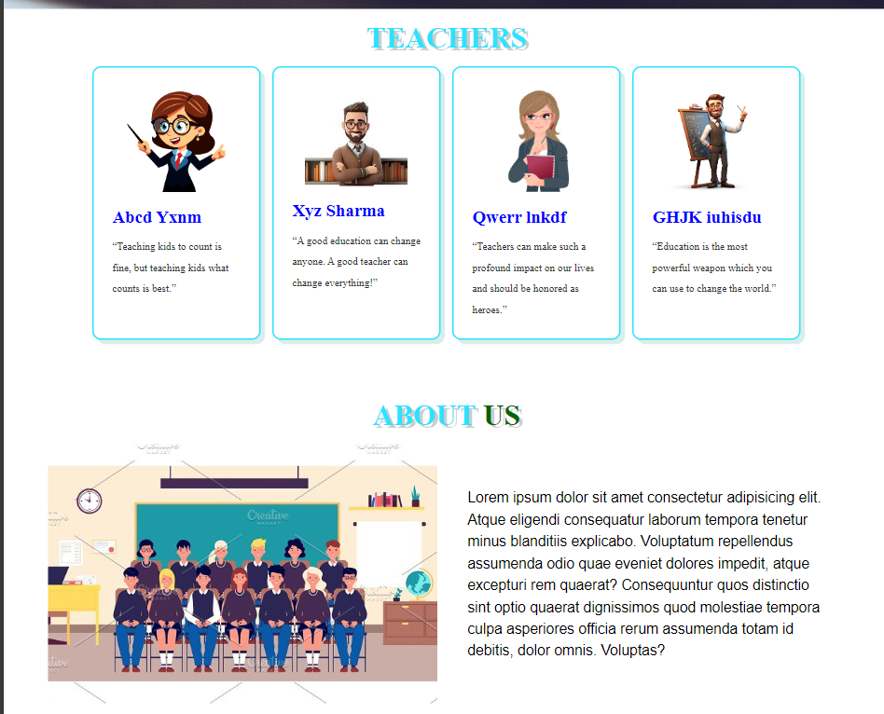
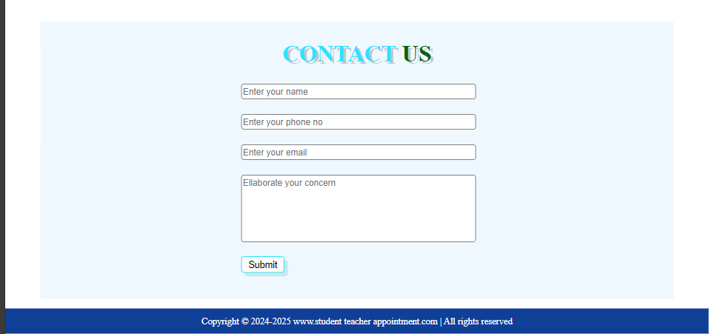
SCREENSHOTS

Slide 12
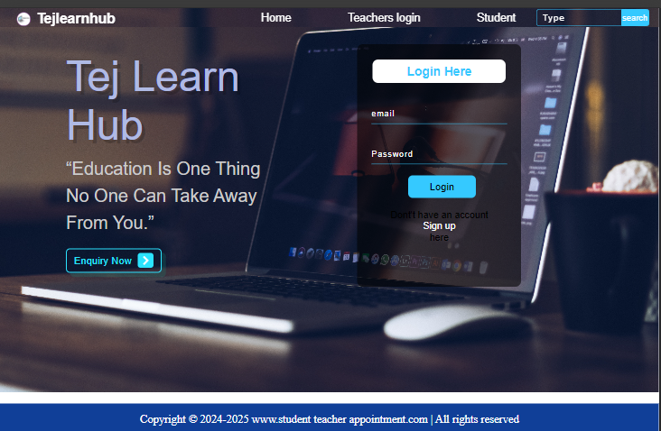
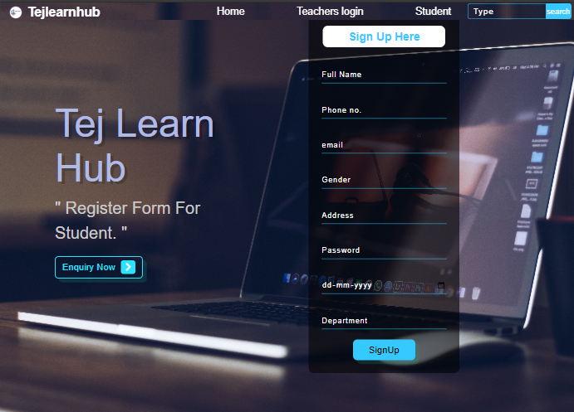
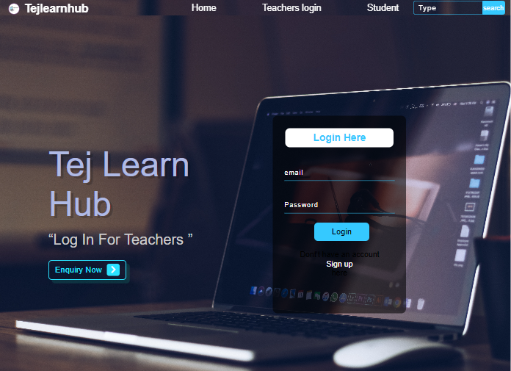
SCREENSHOTS

Slide 13
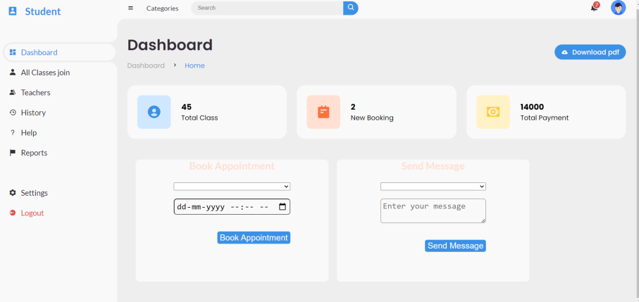
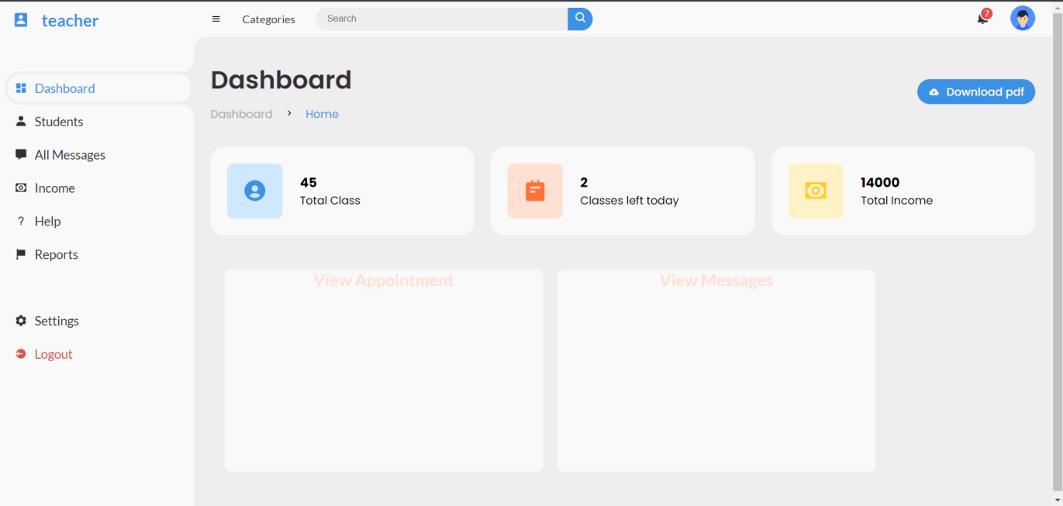
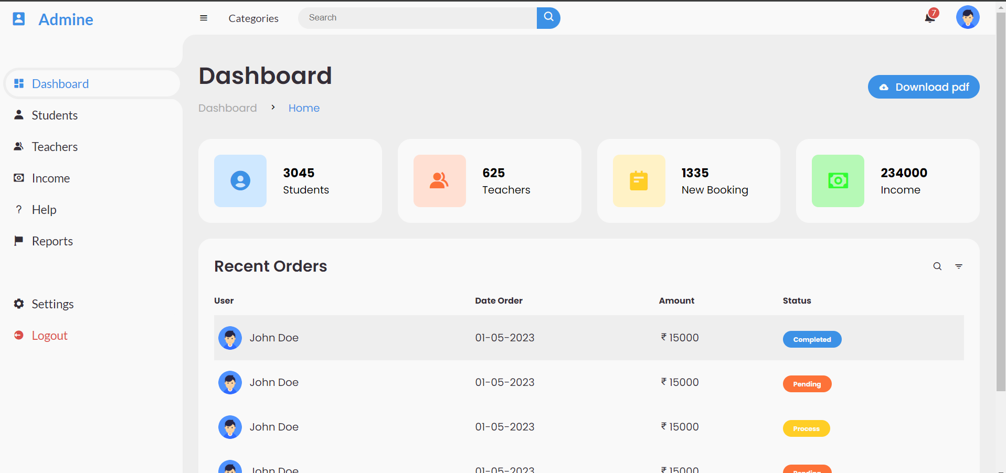
SCREENSHOTS

Slide 14
CONCLUSION
The Student-Teacher Booking Website is designed to foster effective communication and scheduling, making academic support more accessible and organized.
Whether you are a student seeking help, a teacher managing your time, or an admin overseeing operations, this platform provides the tools needed to streamline educational interactions.
My GitHub repo : https://github.com/SurukuluGobinda/Student-Teacher-Booking-Appointment

